Slide 1

July 2021
CONGRESS.GOV
Recent Enhancements
Bulk Data Task Force

Slide 2
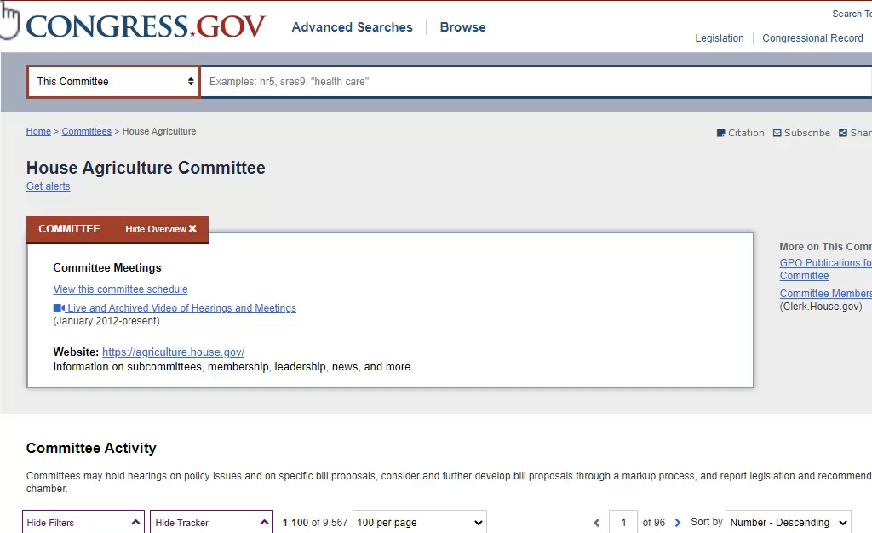
1. Set up committee alerts

Slide 3
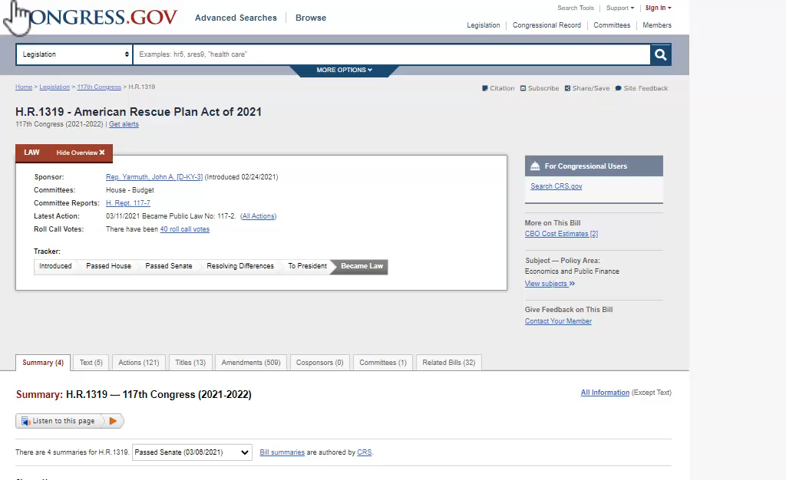
1. Set up committee alerts
2. Use citation tool

Slide 4
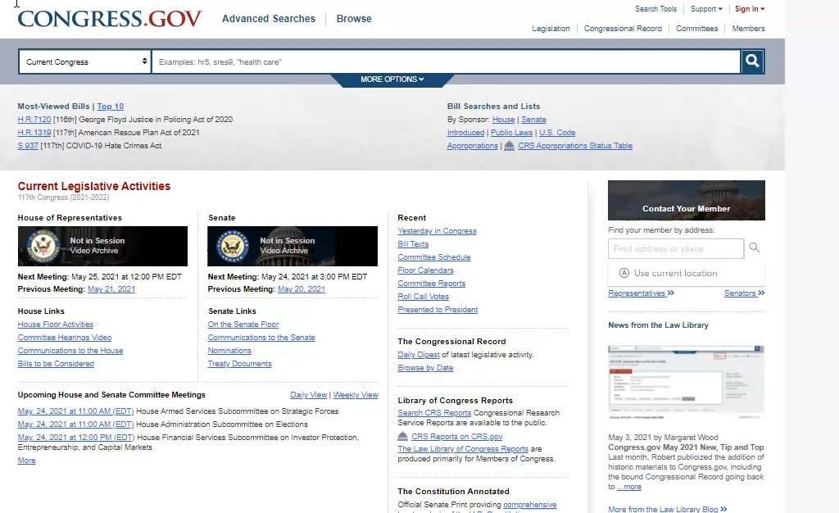
1. Set up committee alerts
2. Use citation tool
3. Contact your Member

Slide 5
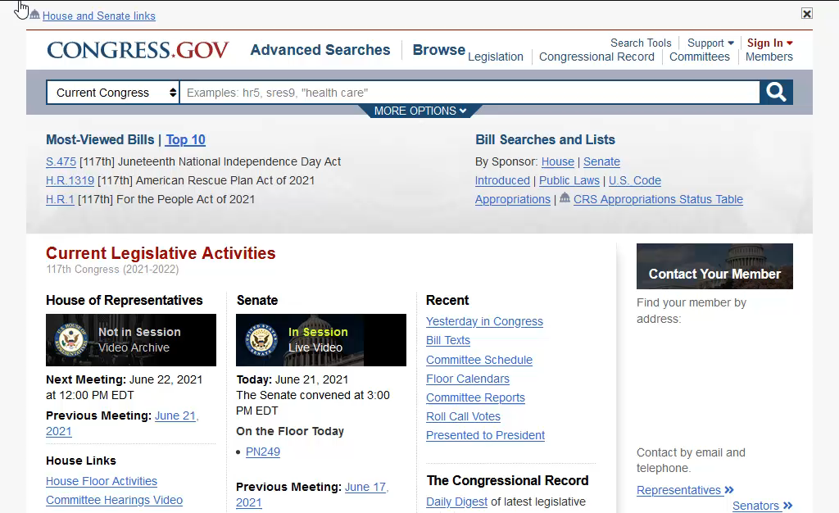
1. Set up committee alerts
2. Use citation tool
3. Contact your Member
4. Consolidate saved searches into a single email message

Slide 6
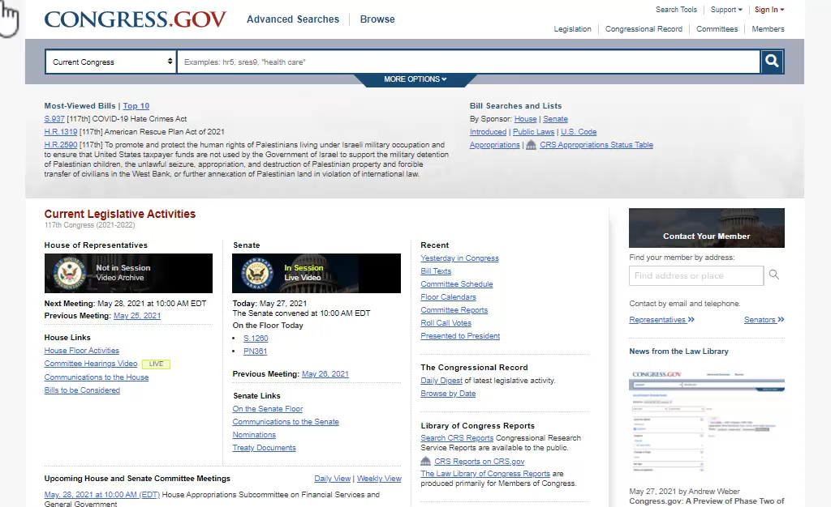
1. Set up committee alerts
2. Use citation tool
3. Contact your Member
4. Consolidate saved searches into a single email message
5. Law text available dating from 1951

Slide 7
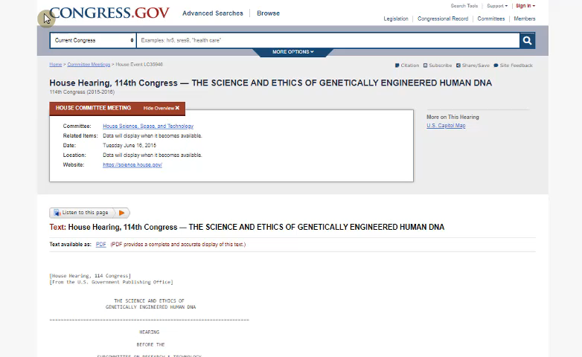
1. Set up committee alerts
2. Use citation tool
3. Contact your Member
4. Consolidate saved searches into a single email message
5. Law text available dating from 1951
6. Listen to this page - hearings

Slide 8
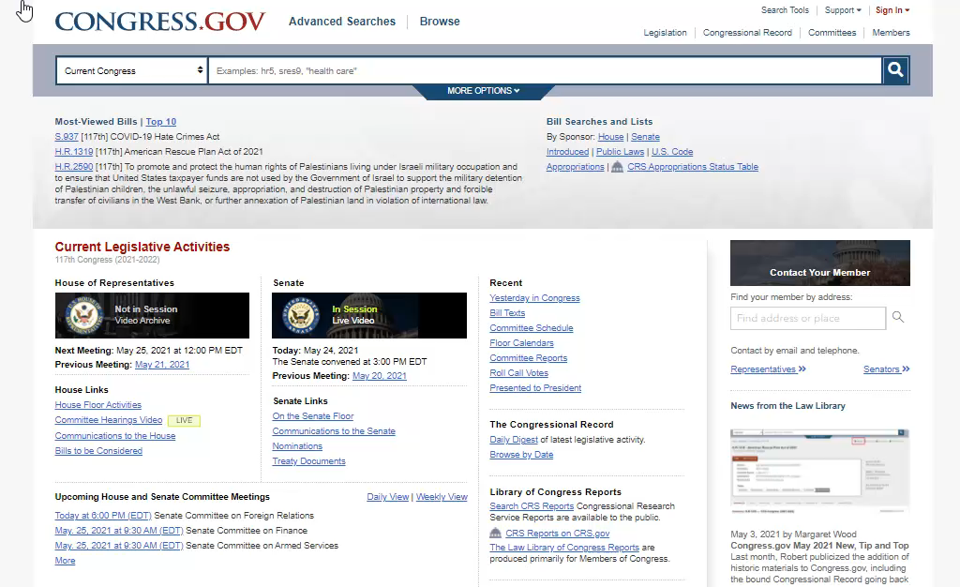
1. Set up committee alerts
2. Use citation tool
3. Contact your Member
4. Consolidate saved searches into a single email message
5. Law text available dating from 1951
6. Listen to this page - hearings
7. Search the Help Center

Slide 9
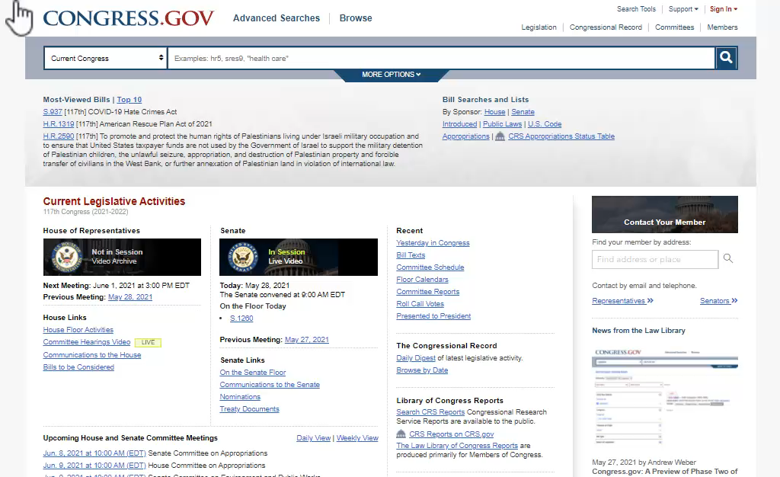
1. Set up committee alerts
2. Use citation tool
3. Contact your Member
4. Consolidate saved searches into a single email message
5. Law text available dating from 1951
6. Listen to this page - hearings
7. Search the Help Center
8. Access historical debates of Congress

Slide 10

1. Set up committee alerts
2. Use citation tool
3. Contact your Member
4. Consolidate saved searches into a single email message
5. Law text available dating from 1951
6. Listen to this page - hearings
7. Search the Help Center
8. Access historical debates of Congress
9. Committee meeting materials available dating from 2001

Slide 11
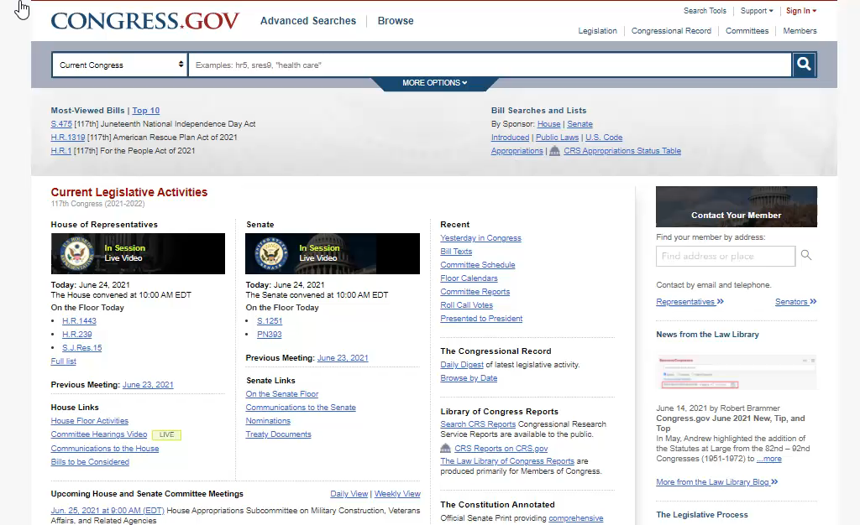
1. Set up committee alerts
2. Use citation tool
3. Contact your Member
4. Consolidate saved searches into a single email message
5. Law text available dating from 1951
6. Listen to this page - hearings
7. Search the Help Center
8. Access historical debates of Congress
9. Committee Schedule available dating from 2001
10. Download bill status bulk XML

Slide 12
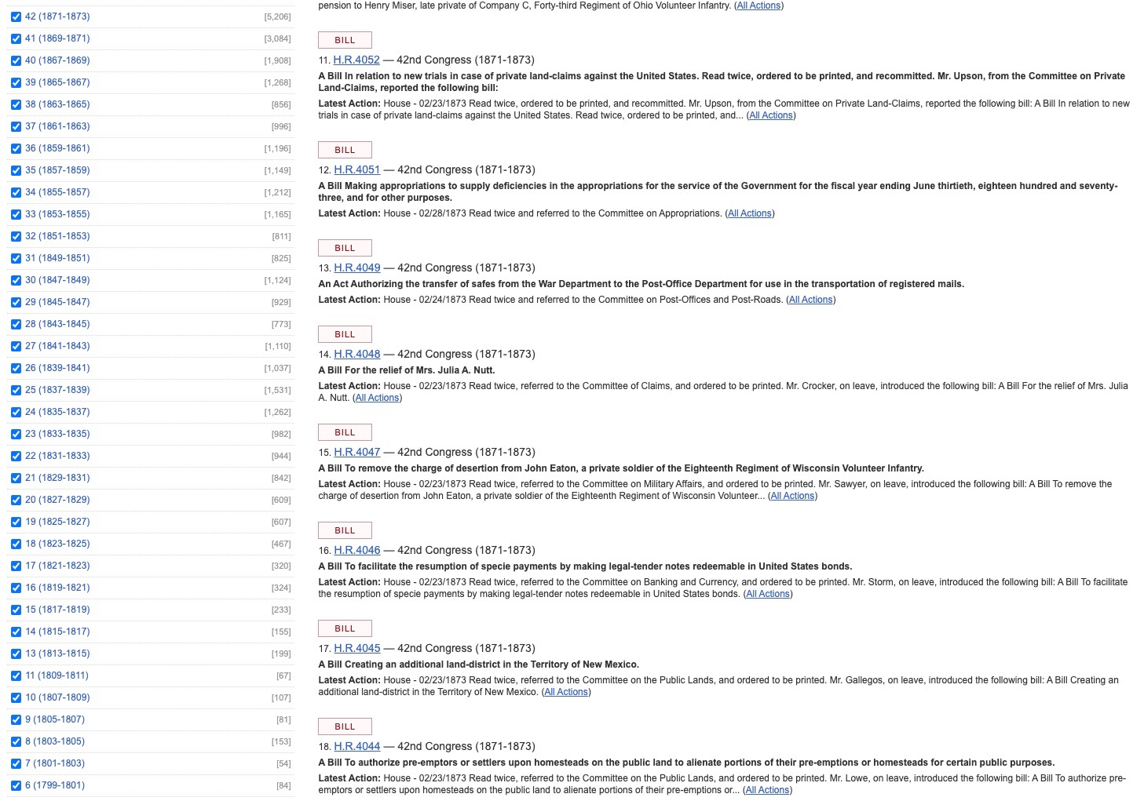
Century of Lawmaking Migration

Slide 13
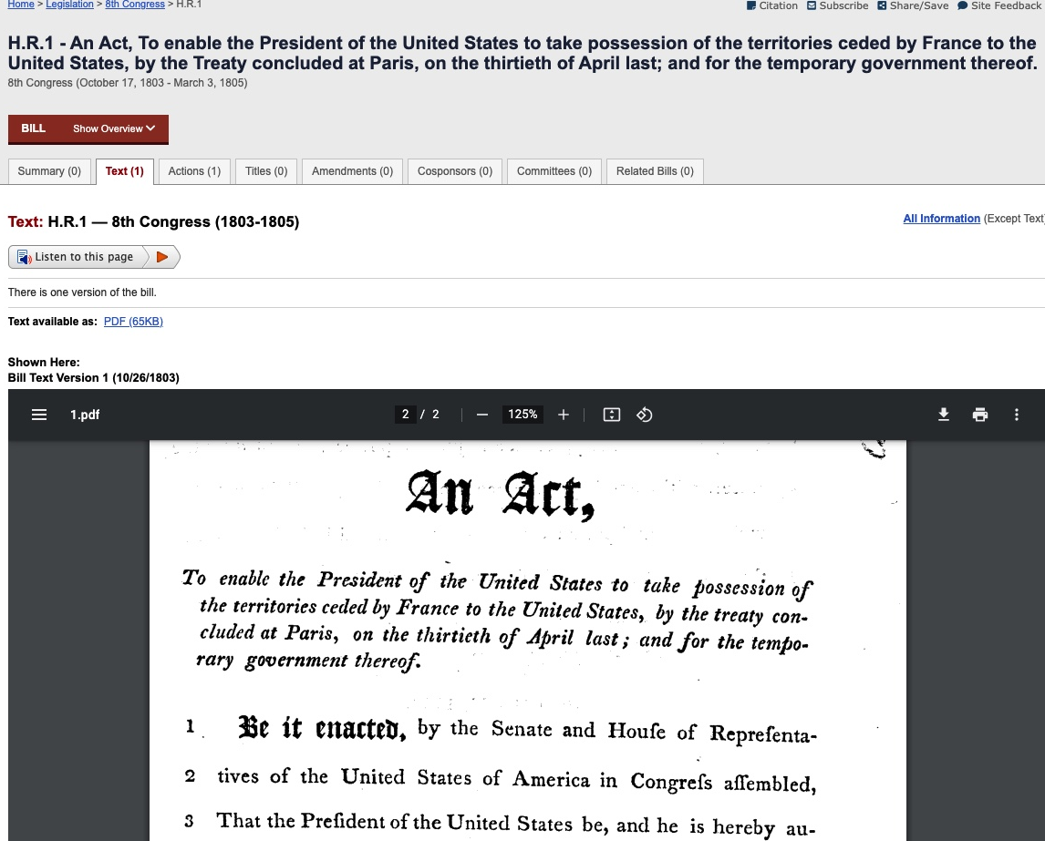
Century of Lawmaking Migration

Slide 14
1. Set up committee alerts
2. Use citation tool
3. Contact your Member
4. Consolidate saved searches into a single email message
5. Law text available dating from 1951
6. Listen to this page - hearings
7. Search the Help Center
8. Access historical debates of Congress
9. Committee Schedule available dating from 2001
10. Download bill status bulk XML
Announcing the Congress.gov Virtual Public Forum on September 2nd!

Slide 15
View more enhancements
https://www.congress.gov/about/enhancements
https://www.congress.gov/rss
1. Set up committee alerts
2. Use citation tool
3. Contact your Member
4. Consolidate saved searches into a single email message
5. Law text available dating from 1951
6. Listen to this page - hearings
7. Search the Help Center
8. Access historical debates of Congress
9. Committee Schedule available dating from 2001
10. Download bill status bulk XML
Send us your feedback
https://www.congress.gov/survey
Contact Us
https://www.congress.gov/contact-us

